Slide 1
Dane County CH 71
Regulation of Icebound Inland Waters

Slide 2
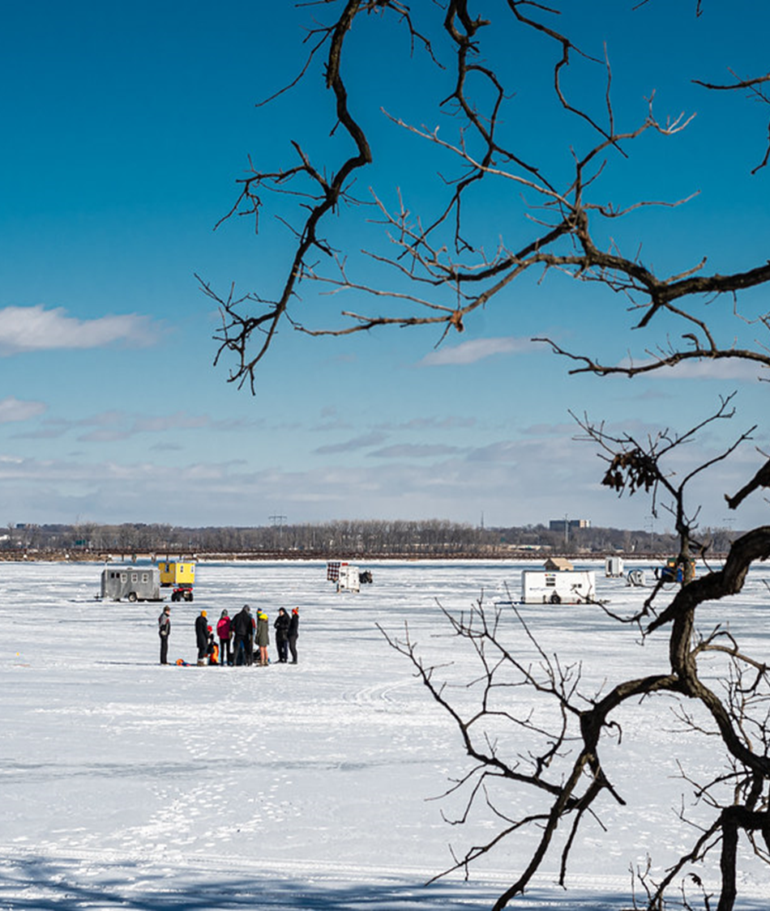
History
Adopted in May 1991
Updated in July 2020
  Removed floatation inspection
Only County in the State with this ordinance
Receive numerous compliance questions annually

Slide 3
Updating CH 71
Feb 5, 2025 – Commission report and discussion on CH 71. LWC recommended gathering public comments.
April 24, 2025 – Joint EANR & LCC meeting. Shared plan for website, public information meeting, press release, & comment submittal.
June 17, 2025 – Public Information Meeting.
July 2, 2025 – Progress report to LWC.
August 6, 2025 – Shared public comments. LWC request for EMS comments.
Sept 3, 2025 – LWC recommends staff work with Corporation Council on drafting amendments.
Dec 3, 2025 – Joint EANR & LCC update.
Jan 7, 2026 – LWC update.
Feb 4, 2026 – Proposed ordinance amendments shared with LWC.

Slide 4
Updating CH 71 (continued)
March 4, 2026 – LWC Public Comments on proposed OA. LWC approved introducing the OA to County Board.
June 5, 2026 – County Board refers 2026 OA-005 to LWC, EANR, & PP&J.
June 30, 2026 – PP&J recommends approval of 2026 OA-005.
July 1, 2026 – LWC recommends approval of 2026 OA-005.
July 7, 2026 – EANR recommends approval of 2026 OA-005.
July 16, 2026 – County Board re-refers 2026 OA-005 to EANR.

Slide 5
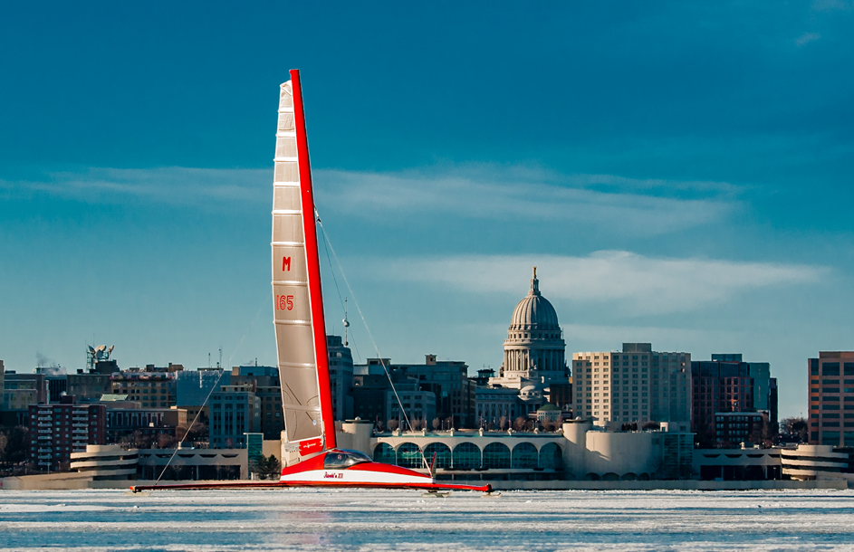
Law Enforcement & LWRD Comments
Goal: To protect public safety while balancing public access and implementation of the ordinance
Limit ice access strictly to DNR-registered vehicles
Remove weight and floatation requirements entirely
Require personal floatation devices for all riders
Create uniform rules across all Dane County waters

Slide 6
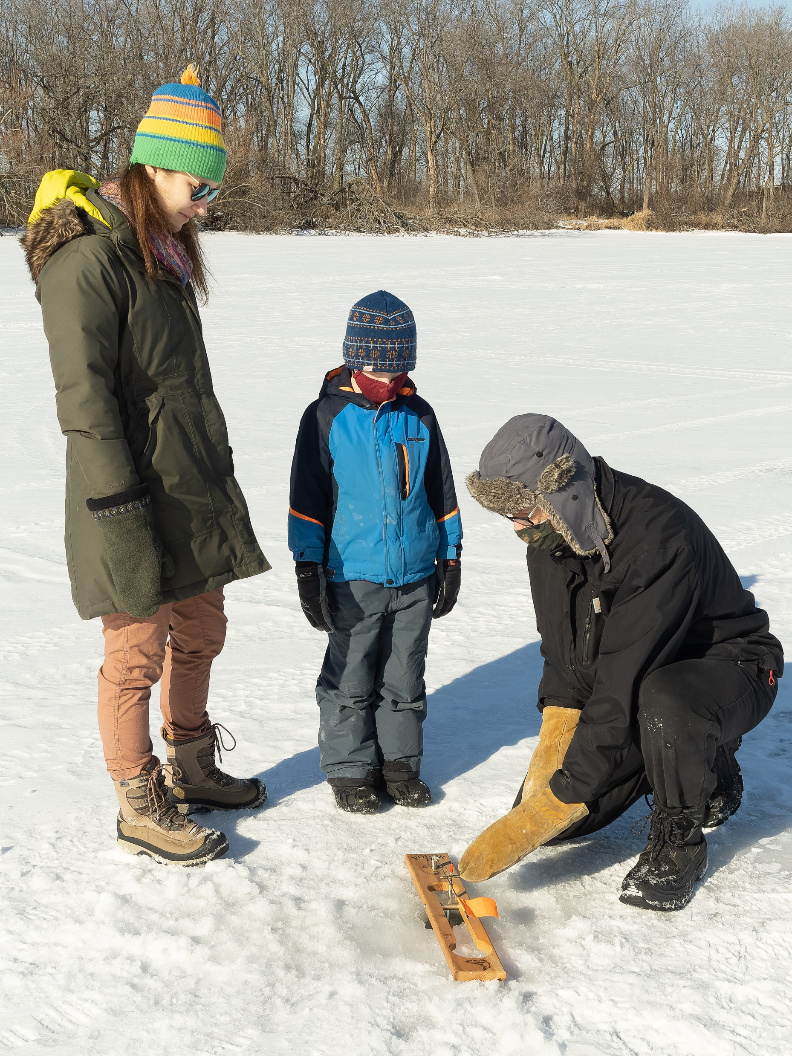
Public Engagement
Website
  Ordinance information
  Public information meeting (6/17/25)
  Form for submitting comments (May 22 – July 15, 2025)
May 28, 2025 press release (WKOW)
LWRD riparian landowner letter
  May 2025
  September 2025

Slide 7
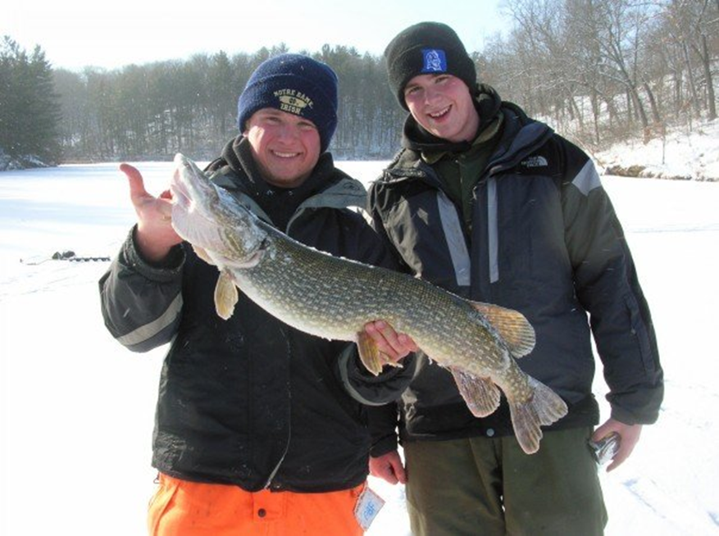
Public Comments
Community Participation
  31 individual comments across 15 municipalities
  1 organizational submission (Yahara Fishing Club)
Key Public Debates
  Weight/Floatation: 16 opposed current limits | 6 supported retention
  UTV Access: 8 supported expansion | 3 opposed expansion
  Climate Factor: 2 requests to account for shorter freezing seasons

Slide 8
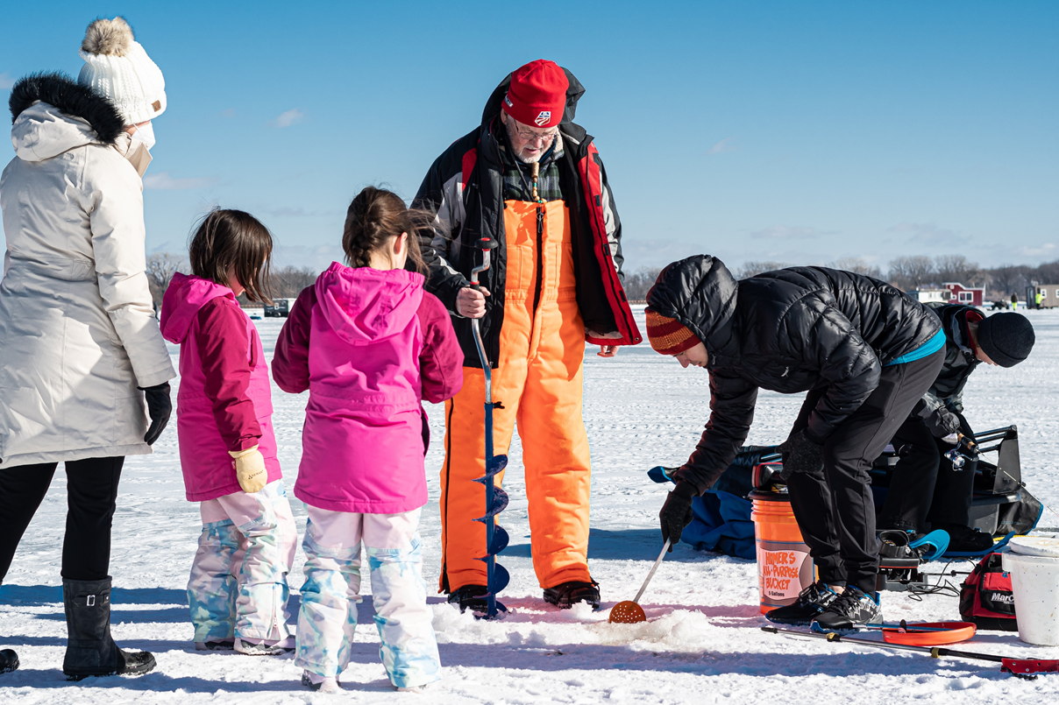
Proposed Ordinance Amendments
Remove the weight restriction of motor vehicles
Limit the type of vehicle that can be operated on icebound lakes to off-highway recreational vehicles
Define off-highway recreational vehicles as all-terrain vehicle (ATV), utility-terrain vehicle (UTV), off-highway motorcycle, or snowmobile, registered by the State of WI or other state.
Requires all operators and passengers to wear personal flotation devices (PFD) wile onboard off-highway recreational vehicles.
Defines wearable personal flotation devices according to WI Administrative Code
Creates uniformity across all icebound lakes in Dane County

Slide 9
Ordinance Amendment Comments
Website
  Proposed ordinance amendment information
  OA public comment meeting (3/4/26)
  Form for submitting comments (Feb – March 9th 2026)
Community Participation
  52 individual comments
    18 municipalities
    1 organizational submission (Yahara Fishing Club)
    5 outside Dane County
Are you in support of the proposed OA
  Neutral: 5
  Yes: 24
  No to Removing Weight Restriction/Floatation: 3
  No to Vehicles: 10
  No to Wearing PFD’s: 4
  No Generally: 6

Slide 10
Frequently Asked Questions
Q. Why is the floatation requirement being removed?
A. Ordinance amendments passed in 2020 no longer require inspections. Currently, there are no commercially available floatation products. Requiring PFD’s to be worn will provide better public safety.
Q. What happens to the vehicle if it falls through the ice if floatation is no longer required.
A. State law requires that the vehicle be removed from the water or the individual who owns the vehicle may face a fine.

Slide 11
FAQ (continued)
Q. Can the ordinance be changed so that I can ride 2 people on my ATV?
A. No the law limiting the number of riders on an ATV is a state law that would supersede this ordinance.
Q. Can I wear my flotation suit instead of a PFD and still meet the requirements of the ordinance?
A. Likely not, most common flotation suits do not meet the wearable PFD definition of this ordinance under WI Administrative Code (NR 5001 (17a)).

Slide 12
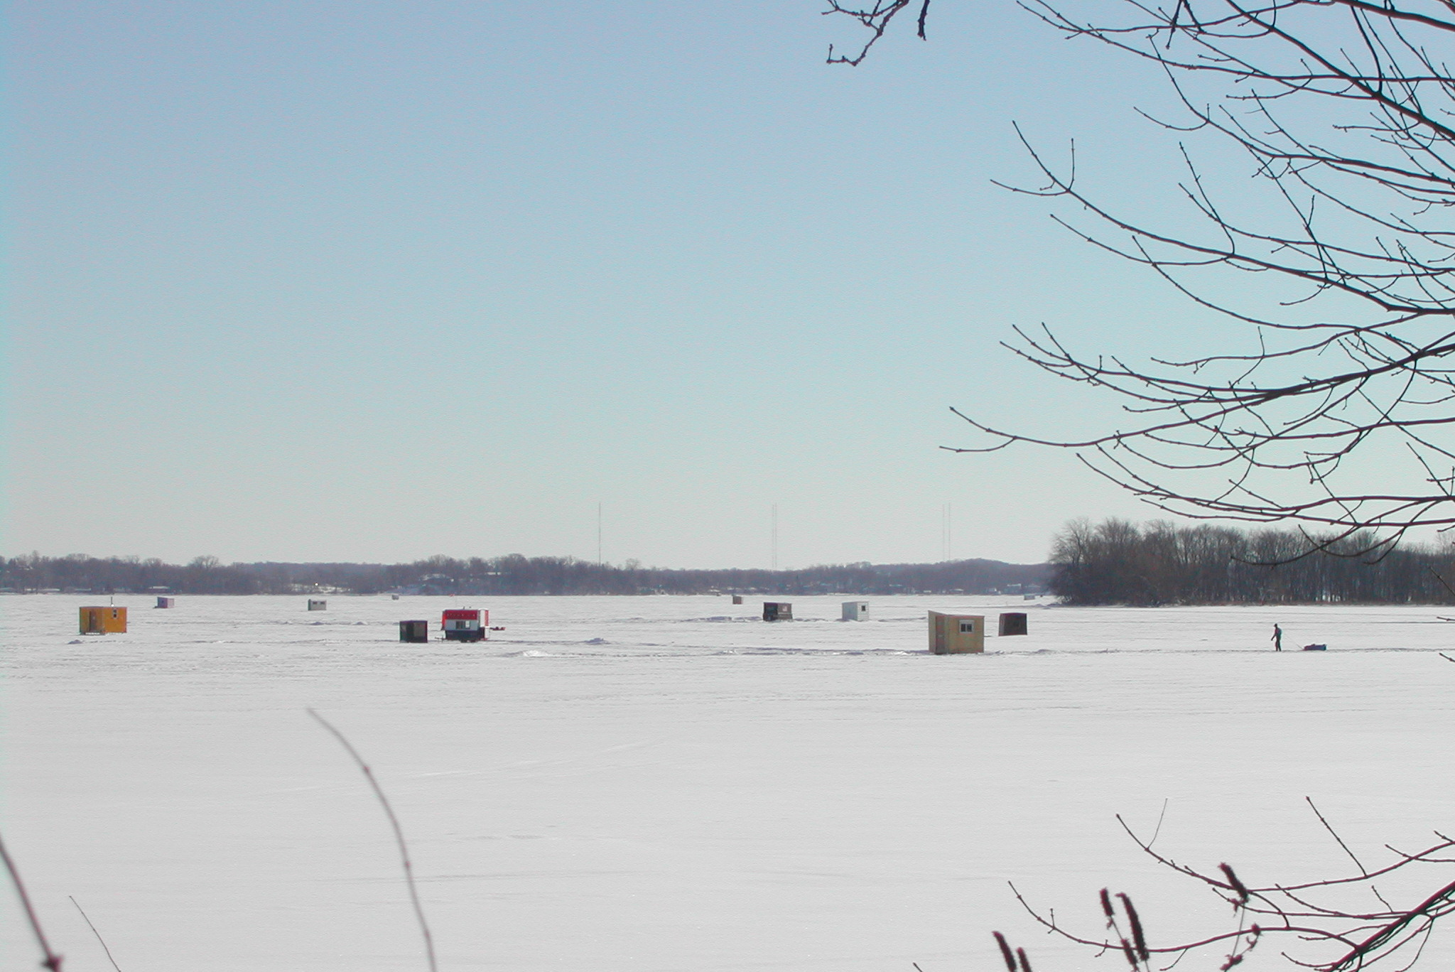
FAQ (continued)
Q. Are their rules on how off-highway recreational vehicles must be operated on the ice?
A. Yes, operation of off-highway recreational vehicles are required to follow statewide rules including noise and reckless operation. Both state and county law enforcement enforce these rules.

Slide 13
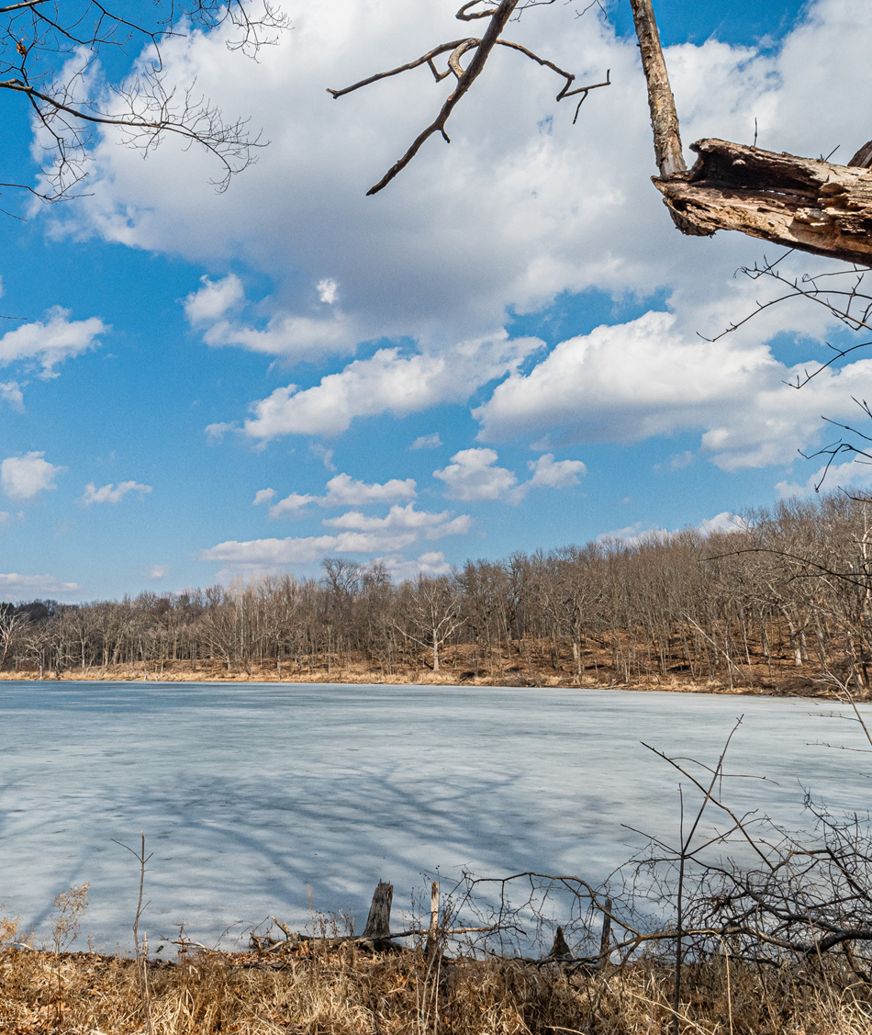
Questions

